Slide 1
Employee Data Analysis using Excel
STUDENT NAME : RAJALAKSHMI S.
REGISTER NO : 312200996 (asunm10942555)
DEPARTMENT : B.Com (General)
COLLEGE : DRBCCC HINDU COLLEGE

Slide 2
PROJECT TITLE
Employee Performance Analysis using Excel

Slide 3


AGENDA
Problem Statement
Project Overview
End Users
Our Solution and Proposition
Dataset Description
Modelling Approach
Results and Discussion
Conclusion

Slide 4

PROBLEM STATEMENT
In an organization with a diverse workforce, there is a need to systematically evaluate employee performance to ensure alignment with organizational goals and identify areas for improvement. The current performance evaluation process lacks consistency, relies heavily on subjective assessments, and does not effectively utilize available data to provide actionable insights. As a result, there are challenges in recognizing high performers, addressing underperformance, and making informed decisions about promotions, training, and development. The goal is to develop a comprehensive performance analysis system that incorporates objective metrics, employee feedback, and managerial assessments to provide a holistic view of employee performance. This system should enable more accurate performance evaluations, support fair and transparent decision-making, and ultimately contribute to improved employee satisfaction and organizational effectiveness.

Slide 5

PROJECT OVERVIEW
The project “Employee Performance Analysis Using Excel” aims to systematically evaluate employee productivity and effectiveness by using Excel’s analytical tools. The data will be processed and analyzed using Excel functions like conditional formatting, filtering, formulas, pivot tables, slicer and charts. The outcome will help in identifying top performers and making data-driven decisions for performance improvement. The Final result will include a detailed report and data visualization for easy interpretation and strategic planning.

Slide 6




WHO ARE THE END USERS?
Employees
HR Managers
Department Heads
Company

Slide 7

OUR SOLUTION AND ITS VALUE PROPOSITION
Comprehensive Insights: Our solution offers a holistic view of employee performance by integrating multiple data sources, including productivity metrics, peer reviews, and self-assessments. This comprehensive analysis helps identify strengths, areas for improvement, and development needs.
Data-Driven Decisions: By leveraging advanced analytics and machine learning, our solution provides actionable insights and predictive analytics. This enables managers to make informed decisions about promotions, training, and team composition based on objective data.
Enhanced Employee Engagement: The solution includes features for continuous feedback and goal setting, fostering an environment of ongoing communication and alignment. This approach not only boosts engagement but also helps employees understand how their work contributes to organizational goals.

Slide 8
OUR SOLUTION AND ITS VALUE PROPOSITION
Customized Development Plans: Our system tailors development plans to individual employee needs based on performance data and career aspirations. This personalized approach ensures that training and development efforts are both relevant and effective.
Efficiency and Scalability: The automated data collection and reporting capabilities reduce the administrative burden on HR teams and managers. Scalable to organizations of all sizes, the solution grows with your company and adapts to changing needs.
Objective Performance Evaluation: By minimizing bias through standardized evaluation criteria and objective metrics, our solution ensures fair and transparent performance reviews, fostering trust and consistency in the evaluation process.
Overall, our employee performance analysis solution empowers organizations to enhance productivity, retain top talent, and drive overall business success through data-driven insights and personalized development strategies.

Slide 9
Dataset Description
Dataset is taken from Edu net student dashboard.
Description for each of the columns highlighted in the dataset
Employee Id: The identity proof for each employee in an organization.
First Name: The first name of the employee.
Last Name: The last name of the employee.
Business Unit: The specific business unit or department to which the employee belongs.
Employee Status: The current, former or future employee’s relationship with the organization they work for. (e.g. Active or Future start)
Employee Type: It is a classification of employees based on their work schedule or timing. (e.g. part-time, full-time, contract)
Gender Code: A code representing the gender of the employee. (e.g., M for male and F for female)
Performance Score: A score indicating the employee’s performance level. (e.g., exceeds, fully meets, needs improvement)
Current Employee Rating: The current rating or evaluation of the employee’s overall performance in an organization.

Slide 10

THE "WOW" IN OUR SOLUTION
Performance Category
=IFS(Z2>=5,"VERY HIGH",Z2>=4,"HIGH",Z2>=3,"MED",TRUE,"LOW")
Predictive Analytics:
Integrating predictive models to forecast future performance trends based on historical data, giving managers a proactive approach to workforce planning.
Automated Alerts:
The tool can be set up to send automated alerts for critical performance issues, ensuring that managers are immediately notified when attention is needed.
3/21/2024 Annual Review
10

Slide 11
MODELLING
In the “Employee Performance Analysis Using Excel” project, the modelling phase involves setting up the Excel workbook with various tools and techniques to analyze and visualize the data effectively.
Here’s how each component will be used.
Data Collection:
Collecting the data from “Employee Dataset” by highlighting the cells of Employee Id, First Name, Last Name, Business Unit, Employee Status, Employee Type, Gender Code, Performance Score and Current Employee Rating.
Performance Level:
Converting the Current Employee Rating (numbers) into Performance Category (Text) by using the formula.
Performance Category =IFS(Z2>=5,"VERY HIGH",Z2>=4,"HIGH",Z2>=3,"MED",TRUE,"LOW")
11

Slide 12
MODELLING
Data Cleaning:
First, identify the missing value in the “Exit Date” column by using the Conditional formatting technique ( format cells with blanks and fill with red color). Then, remove the blank cells in the Exit Date column by using Filtering technique (filter by color and no fill).
4. Pivot Table:
Pivot Table helps to summarize and analyze large datasets by grouping and aggregating the data based on different performance metrics. It also helps to visualize the data in an easily interpretable format, making trends and patterns more apparent.
In this project, Pivot table is used to show the performance category of the employee based on the different business units. We can also see only the male or female performance category of the different business units by using the filter option in the Pivot Table.
12

Slide 13
MODELLING
Slicer:
In this project, slicer is used to show the different employee type like part-time, full-time and contract. For example, if we choose the full-time employee type in the slicer, we can see only the performance category of full-time employee based on the different business units .
6. Charts:
In this project, Bar Chart is used to show the pictorial representation of the performance category of the employee from a different business unit. We can also see only the male or female performance category of the employee separately.
In this project, Pie chart is used to show the pictorial representation of the specifically high performance category of the employee from a different business unit with a Data Label.
In Bar chart, Trend line is used to show the low performance category of the employee and the equation of the trend line is also shown in the Bar chart.
13

Slide 14
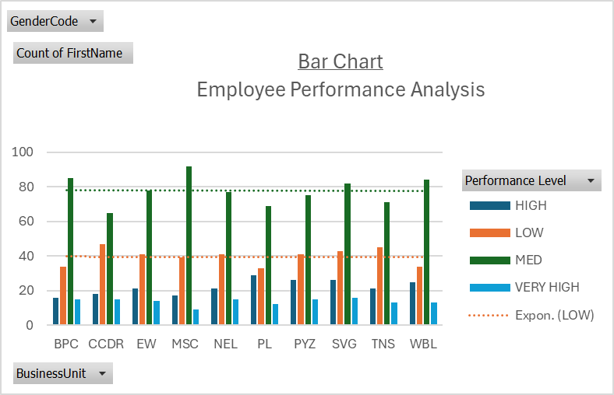
RESULTS
14

Slide 15
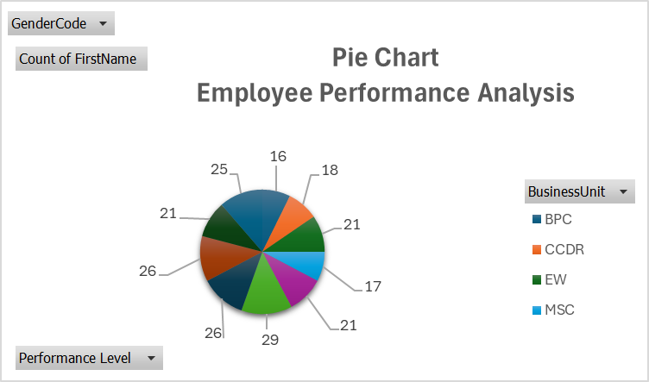
RESULTS
15

Slide 16
Conclusion
The “Employee Performance Analysis Using Excel” project provides a robust and user-friendly solution for evaluating and managing employee performance. By leveraging Excel’s powerful tools such as conditional formatting, filtering, formulas, pivot table, slicer and graph, the project transforms raw performance data into actionable insights. The resulting interactive dashboards and customizable reports empower managers to make data-driven decisions, optimize workforce productivity, and foster continuous improvement across the organization. This solution not only streamlines performance management but also offers a cost-effective, scalable approach to enhancing overall organizational efficiency.
16

Slide 17

Thank You

